Slide 1
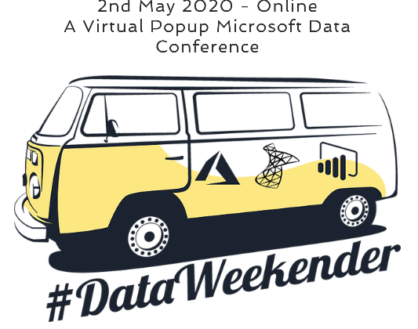
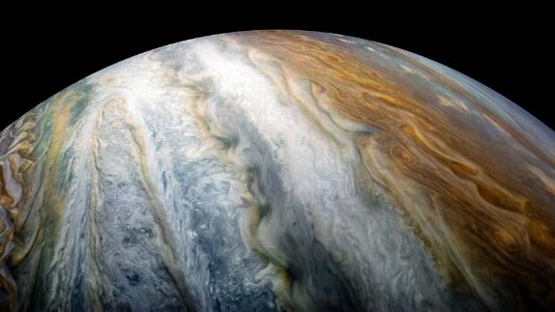
Notebooks in Azure Data Studio for the DBA

Slide 2


Rob Sewell
Consultant
MVP and Beard Twizzler
@SqlDbaWithBeard
beard.media/book

Slide 3
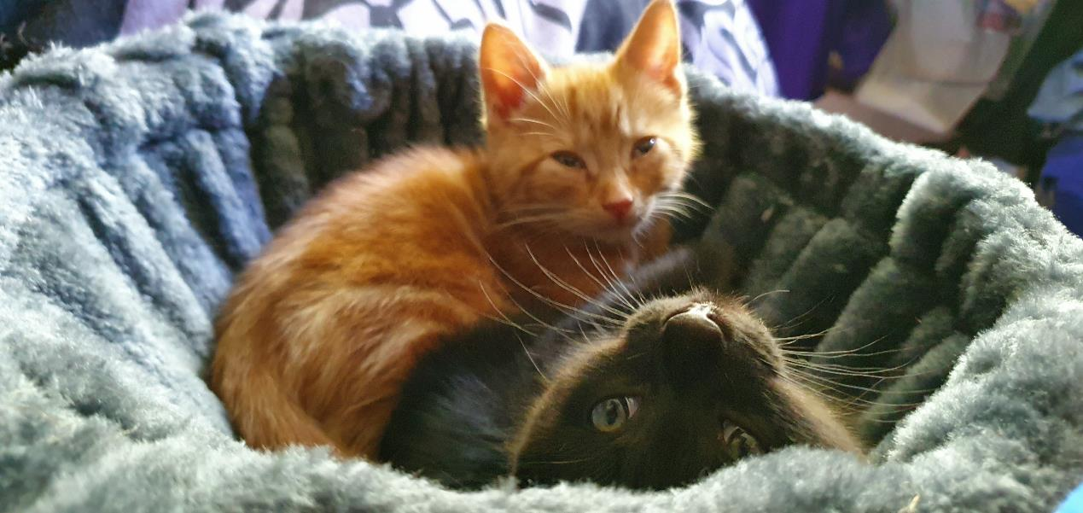
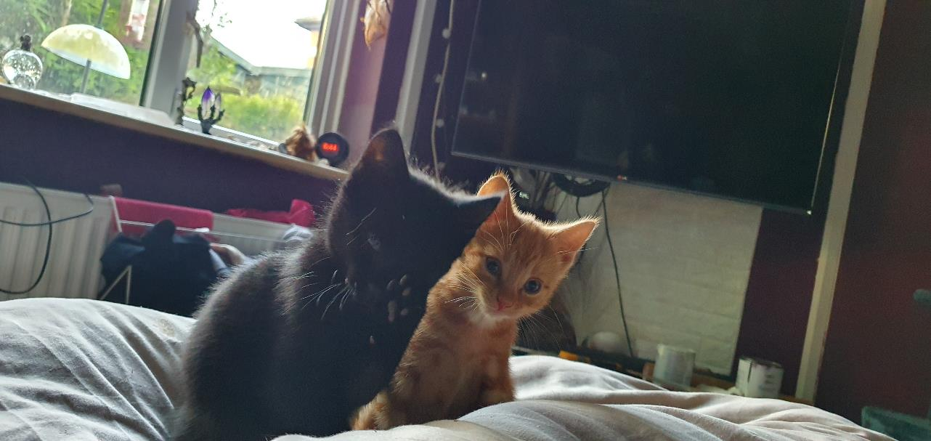
It’s a crazy time – Sometimes, we all need something cute to look at – Luckily I have just the thing

Slide 4

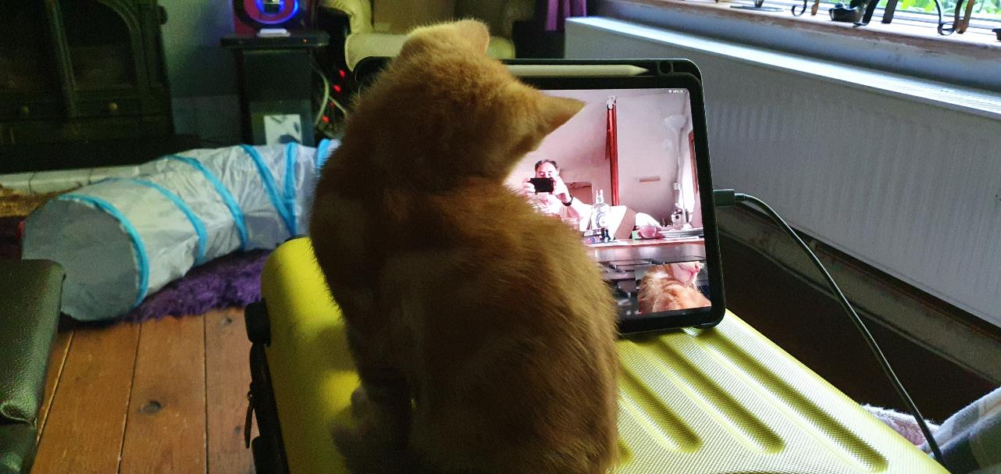
It’s a crazy time – Sometimes, we all need something cute to look at – Luckily I have just the thing

Slide 5

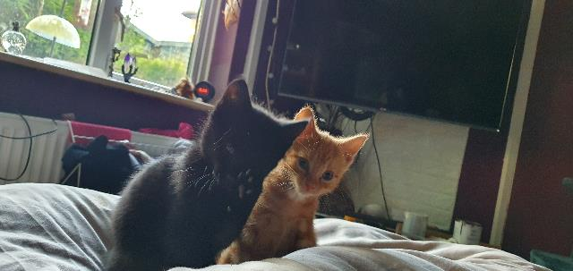
It’s a crazy time – Sometimes, we all need something cute to look at – Luckily I have just the thing

Slide 6

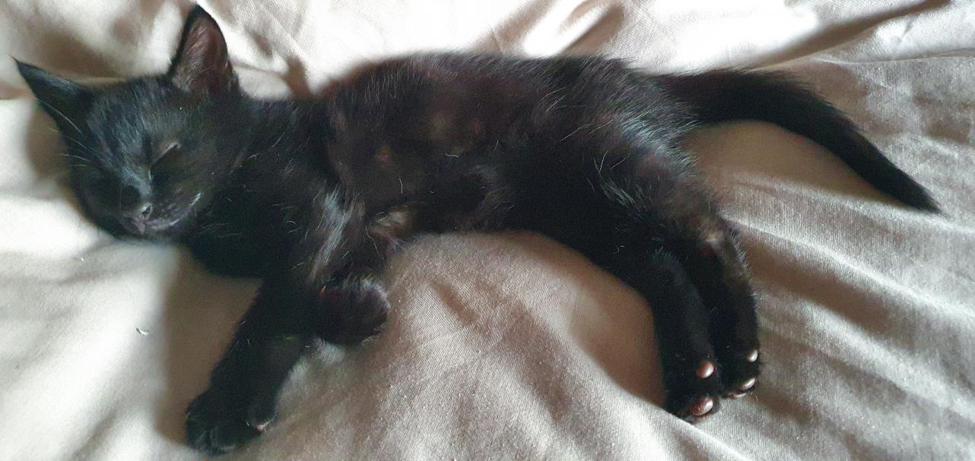
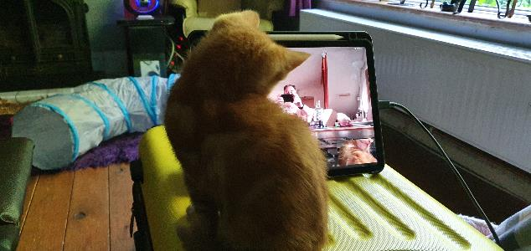
It’s a crazy time – Sometimes, we all need something cute to look at – Luckily I have just the thing

Slide 7
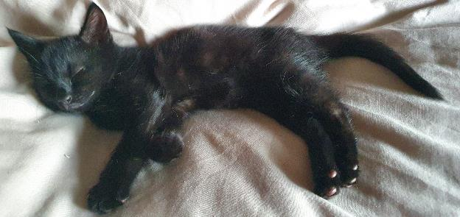
It’s a crazy time – Sometimes, we all need something cute to look at – Luckily I have just the thing

Slide 8
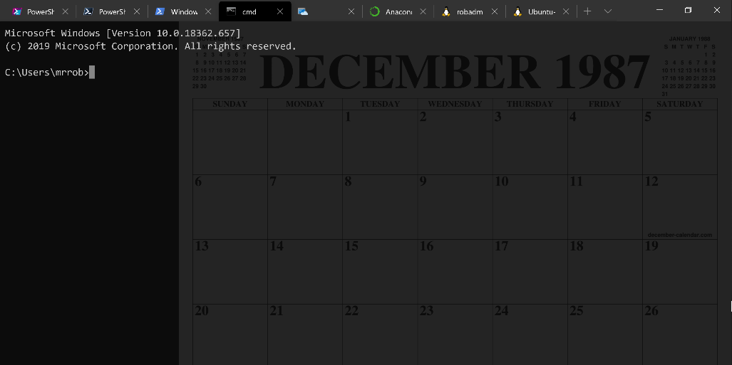
Running Queries
@SQLDBAWithBeard SqlDbaWithABeard.com Rob Sewell beard.media/book

Slide 9
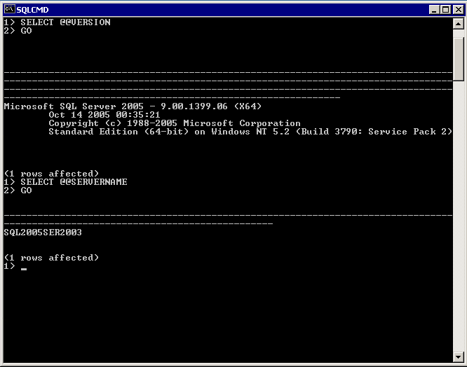
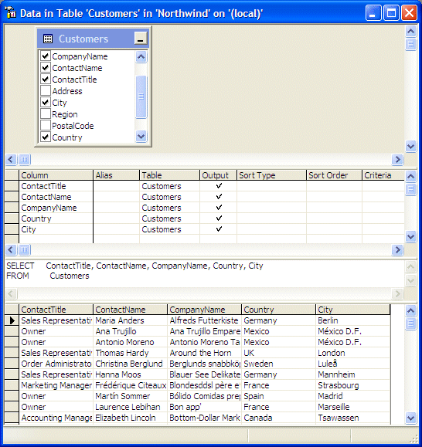
@SQLDBAWithBeard SqlDbaWithABeard.com Rob Sewell beard.media/book

Slide 10
Two and a Half Decades

Slide 11
Uh, Houston, we've had a problem
https://en.wikipedia.org/wiki/Houston,_we_have_a_problem
@SQLDBAWithBeard SqlDbaWithABeard.com Rob Sewell beard.media/book

Slide 12
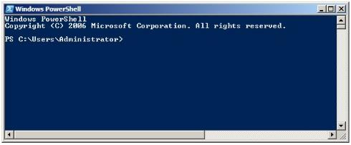
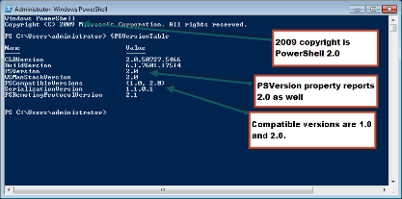
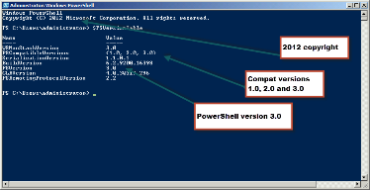
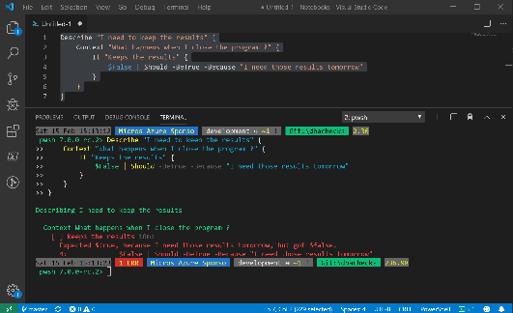
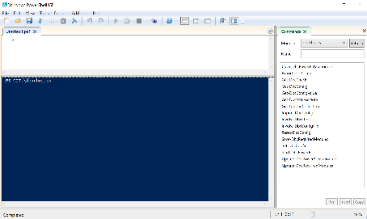
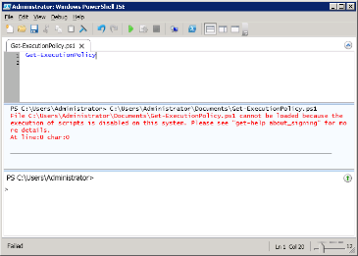
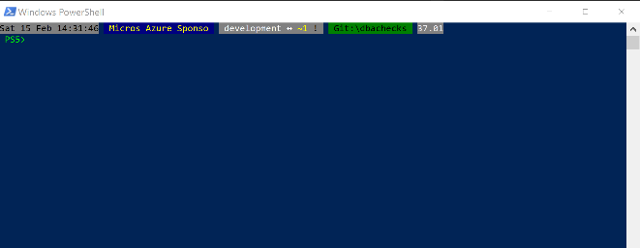
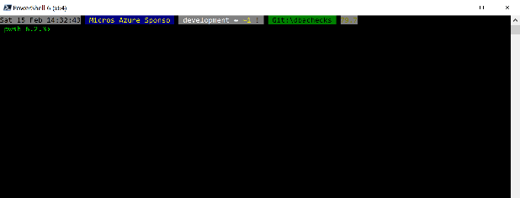
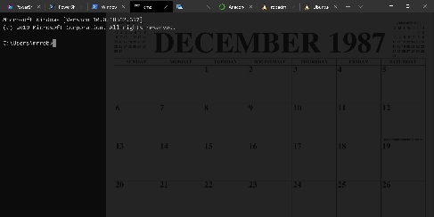
Without some effort………..

Slide 13
Without some effort………..

Slide 14
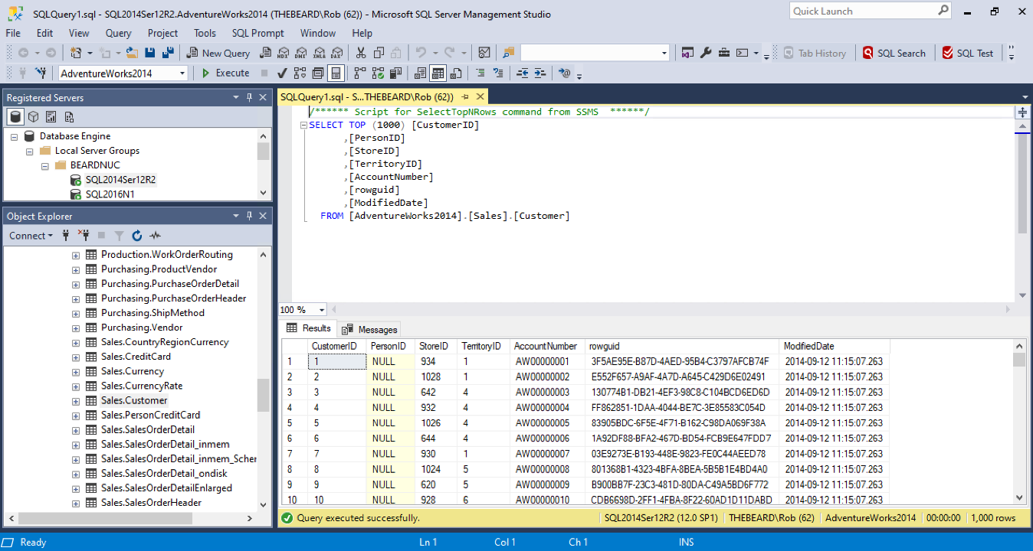

Slide 15
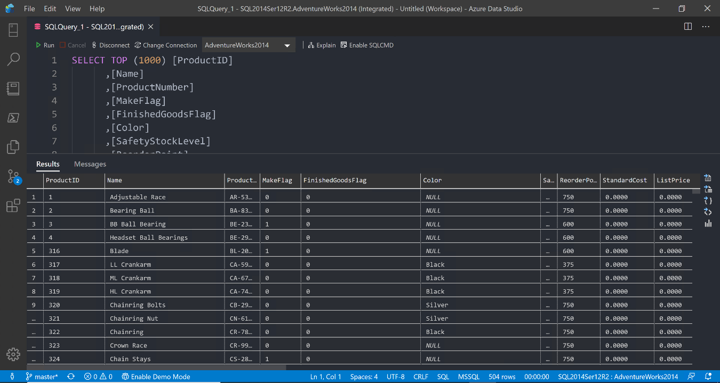

Slide 16
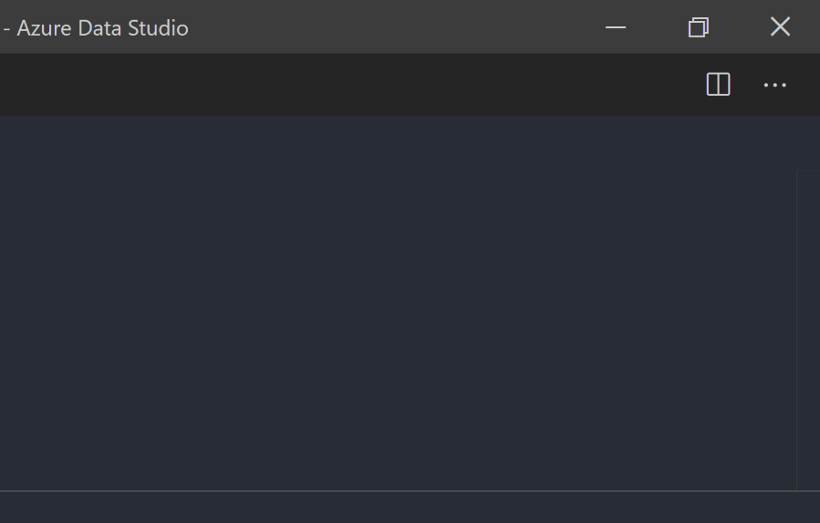
@SQLDBAWithBeard SqlDbaWithABeard.com Rob Sewell beard.media/book

Slide 17

@SQLDBAWithBeard SqlDbaWithABeard.com Rob Sewell beard.media/book

Slide 18

@SQLDBAWithBeard SqlDbaWithABeard.com Rob Sewell beard.media/book

Slide 19
ALL
GONE
@SQLDBAWithBeard SqlDbaWithABeard.com Rob Sewell beard.media/book

Slide 20
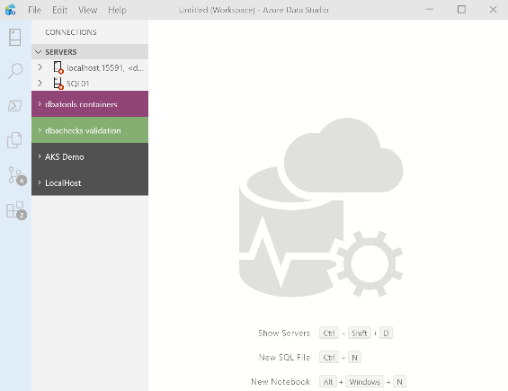
What’s Azure Data Studio ?
Cross Platform desktop environment for Data Professionals
@SQLDBAWithBeard SqlDbaWithABeard.com Rob Sewell beard.media/book

Slide 21

So it’s only for Azure?
@SQLDBAWithBeard SqlDbaWithABeard.com Rob Sewell beard.media/book

Slide 22
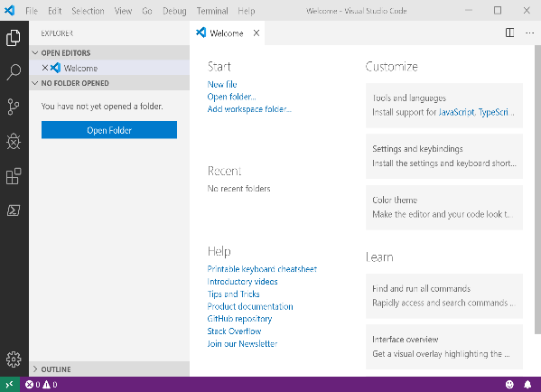
It Looks Like Visual Studio Code ?
@SQLDBAWithBeard SqlDbaWithABeard.com Rob Sewell beard.media/book

Slide 23
It Looks Like Visual Studio Code ?
@SQLDBAWithBeard SqlDbaWithABeard.com Rob Sewell beard.media/book

Slide 24
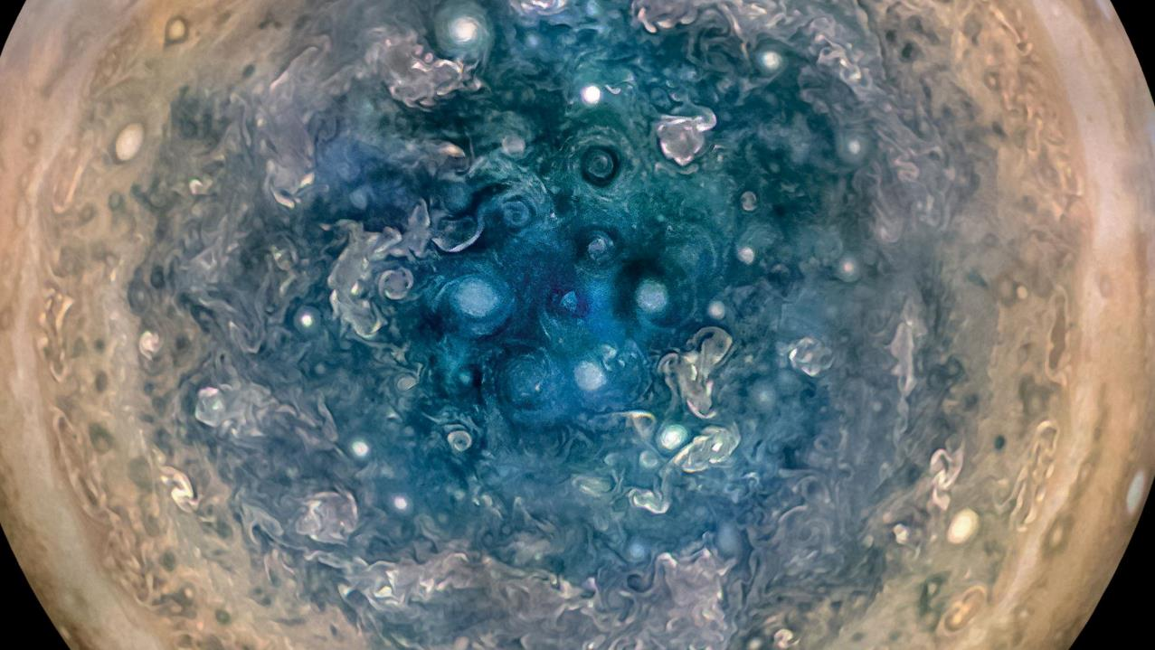

Slide 25
Jupyter

Slide 26
Jupyter
First, the name comes from the planet Jupiter. We wanted to pick a name that evoked the traditions and ideas of science.
https://github.com/jupyter/design/wiki/Jupyter-Logo

Slide 27
Jupyter
Second, the core programming languages supported by Jupyter are
Julia, Python and R.
While the name Jupyter is not a direct acronym for these languages, it nods its head in those directions.
In particular, the "y" in the middle of Jupyter was chosen to honor our Python heritage.
https://github.com/jupyter/design/wiki/Jupyter-Logo

Slide 28
Jupyter
Third, Galileo was the first person to discover the moons of Jupiter. His publication on the moons of Jupiter is an early example of research that includes the underlying data in the publication.
This is one of the core ideas and requirements for scientific reproducibility.
Reproducibility is one of the main focuses of our project.
https://github.com/jupyter/design/wiki/Jupyter-Logo

Slide 29
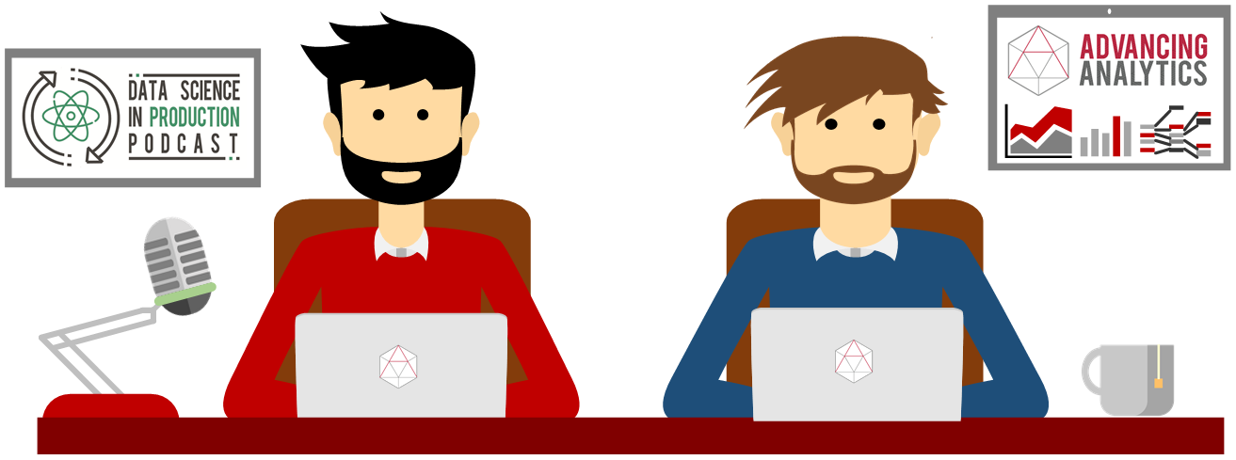
What is a Jupyter Notebook?
Originally for Data Scientists

Slide 30
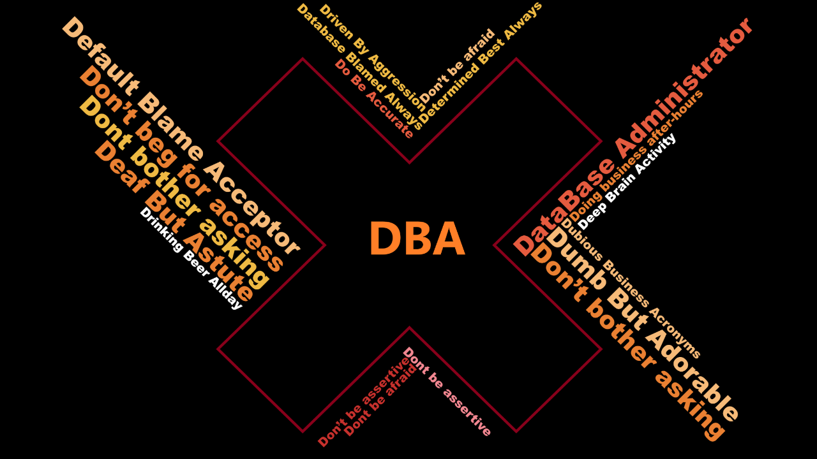

Slide 31
What is a Jupyter Notebook?
Document that can contain text, code, images and query results
@SQLDBAWithBeard SqlDbaWithABeard.com Rob Sewell beard.media/book

Slide 32

Hey Beardy – Enough Talk!
Time For A DEMO

